Slide 1
2024 3rd International Conference on Advancement in Electrical and Electronic Engineering (ICAEEE),
25-27 April, 2024, Gazipur, Bangladesh
VIoT: A Voice and IoT Controlled
Unmanned Automated Vehicle
Presented by –
Naimur Rahman
Muhammad Sheikh Sadi
Md. Abu Saeed
Department of Computer Science and
Engineering
Khulna University of Engineering &
Technology

Slide 2
Overview
Objectives, Basic Concept and Background
Software Design
Communication Systems
Hardware Design
Issues and Solutions
Application, Future work and Conclusions

Slide 3
Objectives
Seamless integration of Bengali voice commands and remote-controller controls, offering users flexible control
To provide an adaptable interface for both long-range IoT and short-range Bluetooth interactions
To enable precise control via Bluetooth in short-range controls within a 20 meter radius
To enable a minimum delay with IoT that can be controlled from anywhere in the world

Slide 4
Basic Concept
A robotic car
controlled via Android App
with Bengali voice control or traditional remote controller system
by the medium of IoT (Internet of Things) in case of long range
or Bluetooth in case of short range communication

Slide 5
Background
Traditional vehicle control systems lack intuitive interfaces, leading to fragmented functionalities and limited control options.
Existing systems often lack support for diverse control methods like voice commands and remote controller inputs.
Challenges include limitations in control methods and accuracy/reliability of voice recognition systems as well as precision in different distances with short range and long range adaptability.

Slide 6
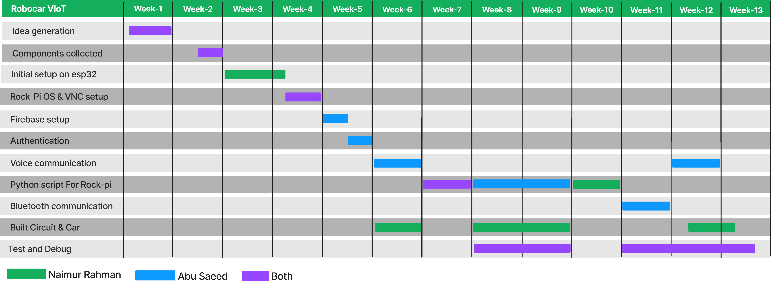
Project Naming & Task Distribution
Robocar VIoT: A Voice and IoT Controlled Robotic Car
IoT Enabled
Voice Controlled (Bengali)

Slide 7
Designs
2 designs were done initially:
Cost-effective way: Only IoT feature using ESP 32 micro-controller
Multi-featured way: Bengali voice control, Bluetooth, Camera added with IoT using Rock Pi 3a micro-controller leaving extra scope for even more future development
Here, we have implemented and will be showcasing the Multi-featured way of our design.

Slide 8
System
Can be divided into 3 separate sectors:
Android App
Communication System
Hardware system

Slide 9
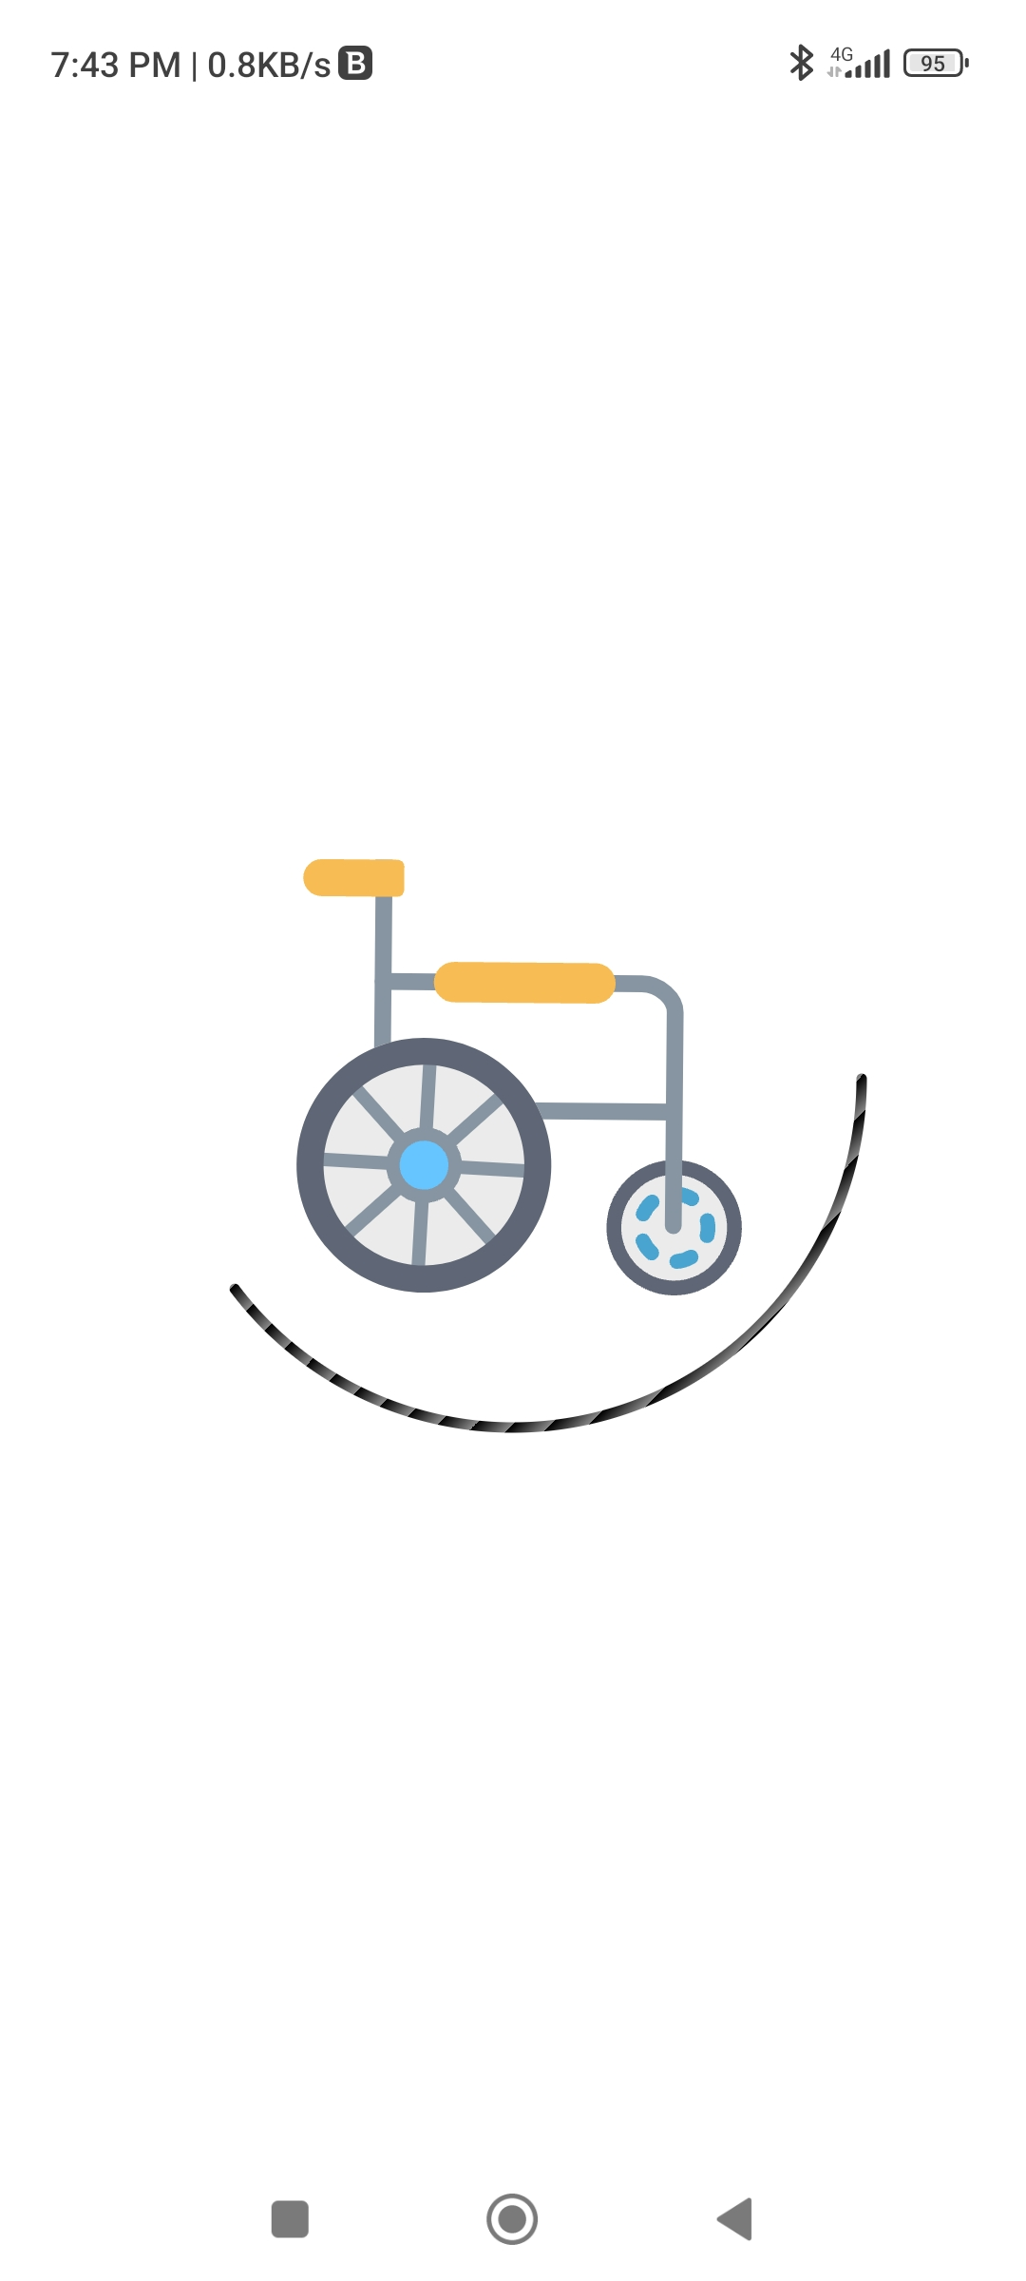
Android App
Consists of several components:
Login system with instructions
Connection establishment
Camera view
Speech recognition API
Remote controller
Log cats

Slide 10
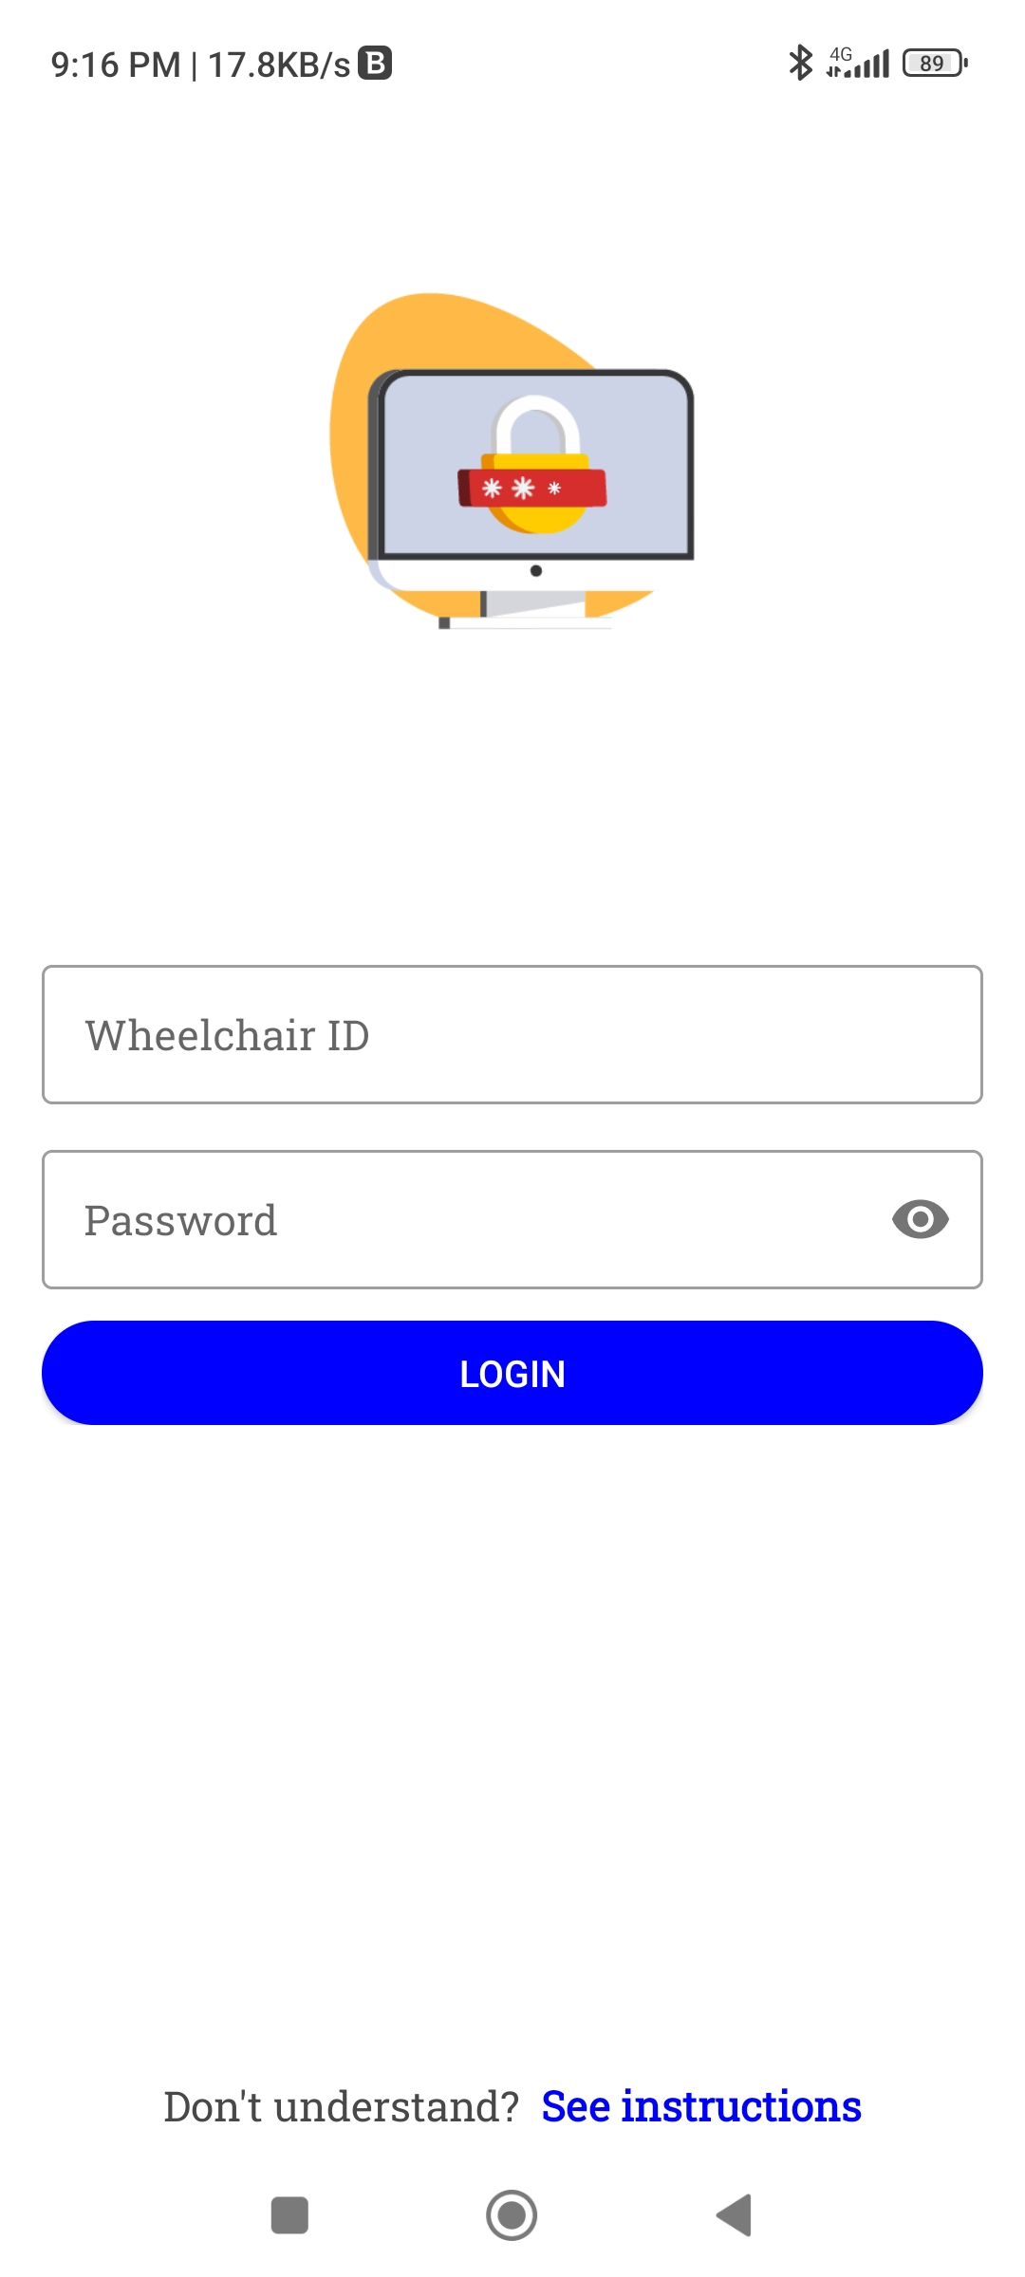
Login System
Requires robocar ID
Along with specific password for that robocar ID
No sign up system
The ID and password will be provided by the manufacturer
That will only be applicable for one specific robocar
User instructions are added in this page to navigate the App

Slide 11
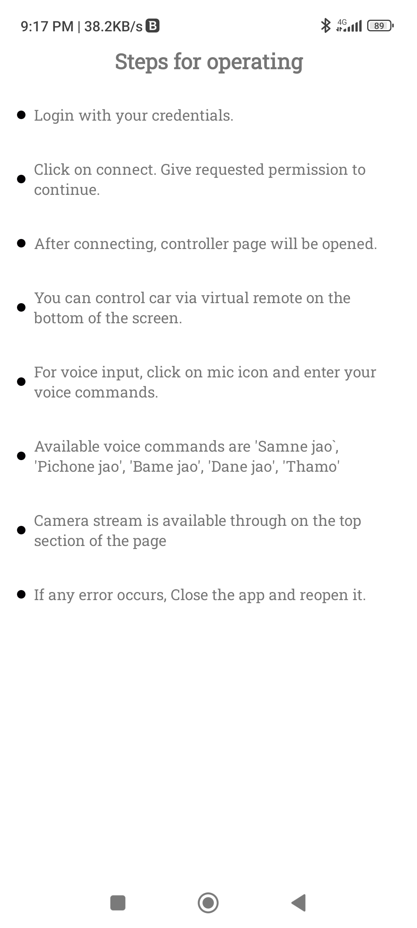
Login System (continued)
Robocar ID accesses the specific robocar
ID attached directly into the Firebase database
Along with the password
Correct combination will navigate to the connection establishment page
The ID is plays a crucial role as multiple cars might be developed
This ID uniquely identifies each car

Slide 12
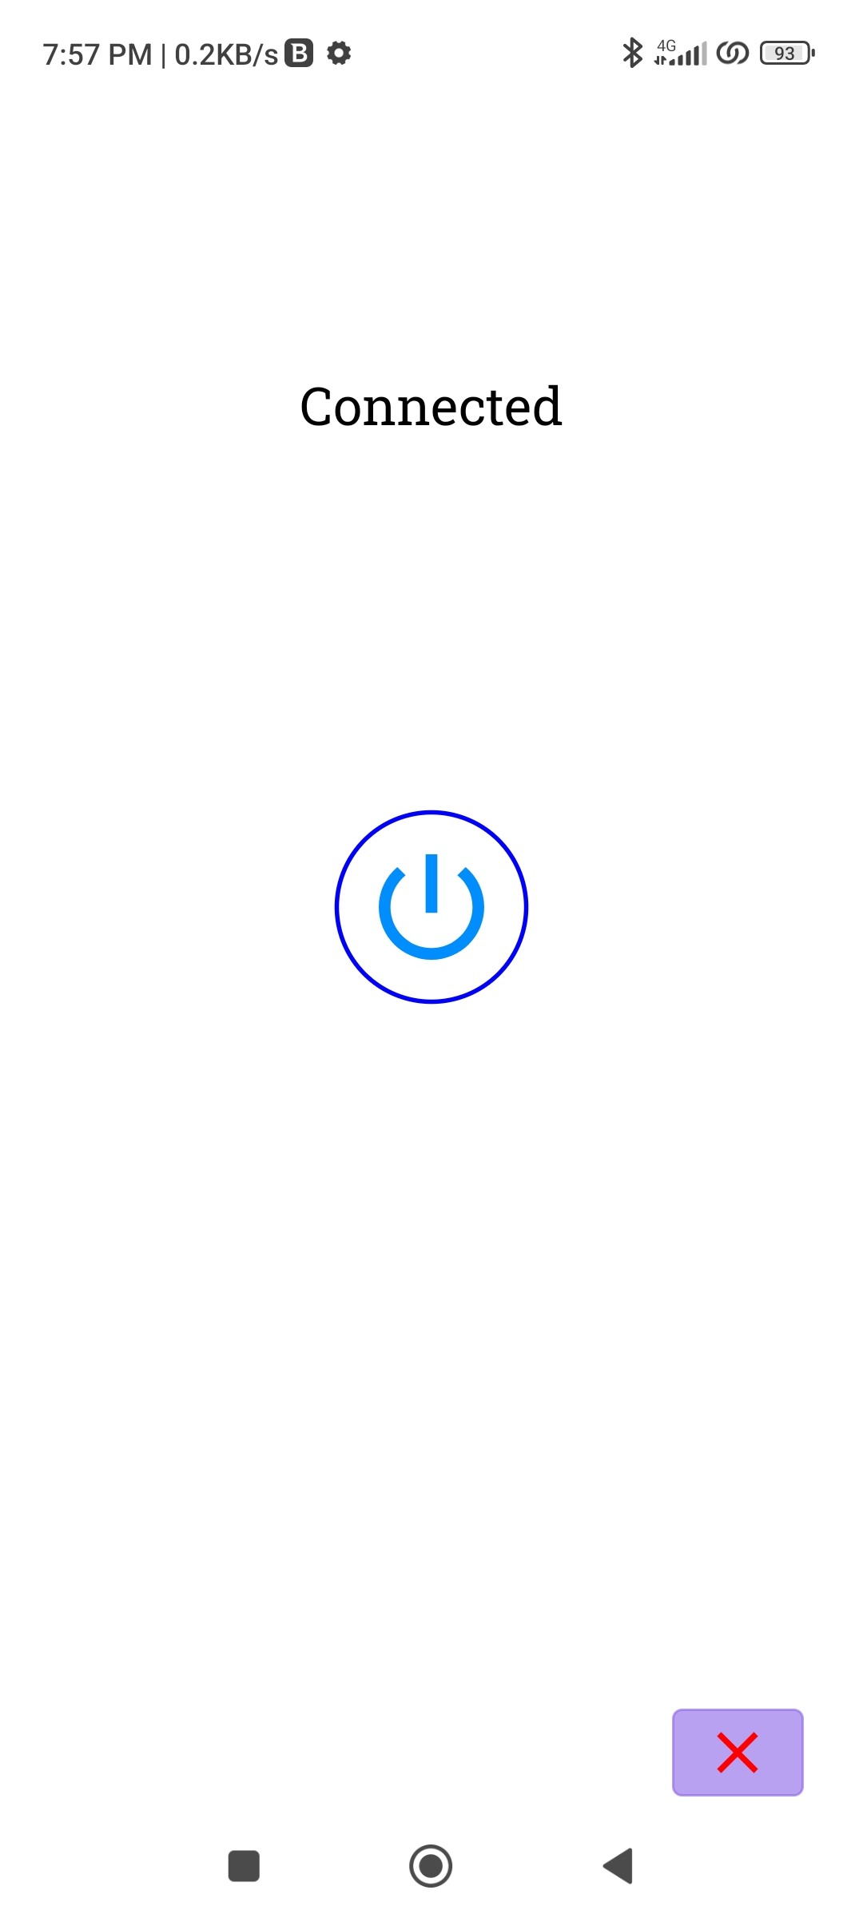
Connection Establishment
Consists of a singular button
Upon pressed tries to establish connection
With Firebase database and Web Socket database
Done to save data of the user
Also a protection for the robocar from unwanted commands
Basically an ON-OFF switch

Slide 13
Database
2 different database is used:
Web Socket database for only sending commands
Less latency
Also less protection and space
Firebase database for Login, Log cats, camera etc.
Firebase has more latency due to extra protection layers
Offers more space

Slide 14
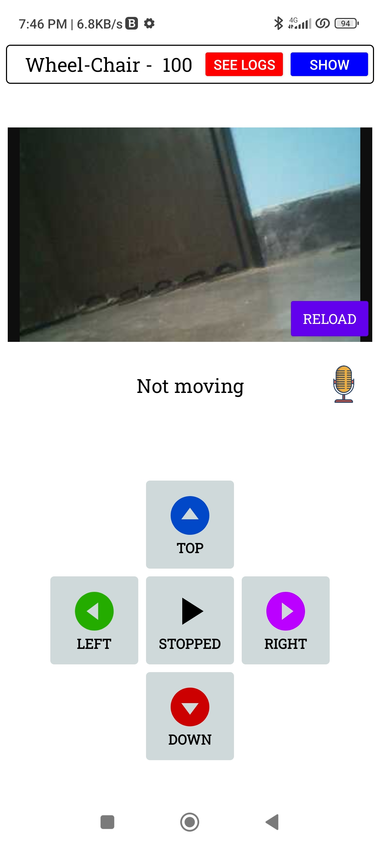
Camera View
Views the video stream provided by the robocar
Uses WebSocket
High latency due to large data

Slide 15
Speech Recognition API
Google speech recognition API used
Listens to the user voice commands
Converts speech to text strings
Bengali Language model is used
Uses 5 sperate commands

Slide 16
Bengali Voice Commands
সামনে যাও (Samne Jao) -> Forward Command
পিছনে যাও (Pichone Jao) -> Backward Command
বামে যাও (Bame Jao) -> Left Command
ডানে যাও (Dane Jao) -> Right Command
থামো (Thamo) -> Stop Command
These commands are first optimized by the Levenshtein algorithm

Slide 17
Levenshtein Algorithm
An optimization algorithm
Also known as the Edit Distance algorithm
A dynamic programming technique used to measure the similarity between 2 strings
Calculates the minimum number of single-character edits required to transform one string into the other
employed to enhance the accuracy of recognizing spoken commands

Slide 18
Levenshtein Algorithm (continued)
6 separate stages:
Preprocessing: Convert the Bengali voice command and the predefined command strings into their corresponding text representations
Matrix Initialization: Create a matrix where the rows and columns correspond to the characters in the voice command and the predefined command respectively

Slide 19
Levenshtein Algorithm (continued)
Dynamic Programming: Populate the matrix by iteratively calculating the minimum edit distances with three possible operations: insertion, deletion, and substitution. The value in each cell is determined by choosing the operation with the minimum cumulative cost.
Backtracking: Once the matrix is filled, backtrack through it to identify the specific sequence of edit operations that yield the minimum edit distance.

Slide 20
Levenshtein Algorithm (continued)
Threshold Setting: Introduce a threshold value to determine an acceptable level of dissimilarity.
Recognition: Based on the calculated edit distances, recognize the Bengali voice command by selecting the predefined command with the minimum distance, thus optimizing the accuracy of voice recognition.

Slide 21
Voice Command System
Optimized strings are converted into integer values:
Forward -> 3
Backward -> 4
Left -> 1
Right -> 2
Stop -> 5

Slide 22
Voice Command System (Continued)
Integer values are stored in Web Socket database for IoT communication
Also passed through Bluetooth system if with in range
These values are later read by the micro-controller

Slide 23
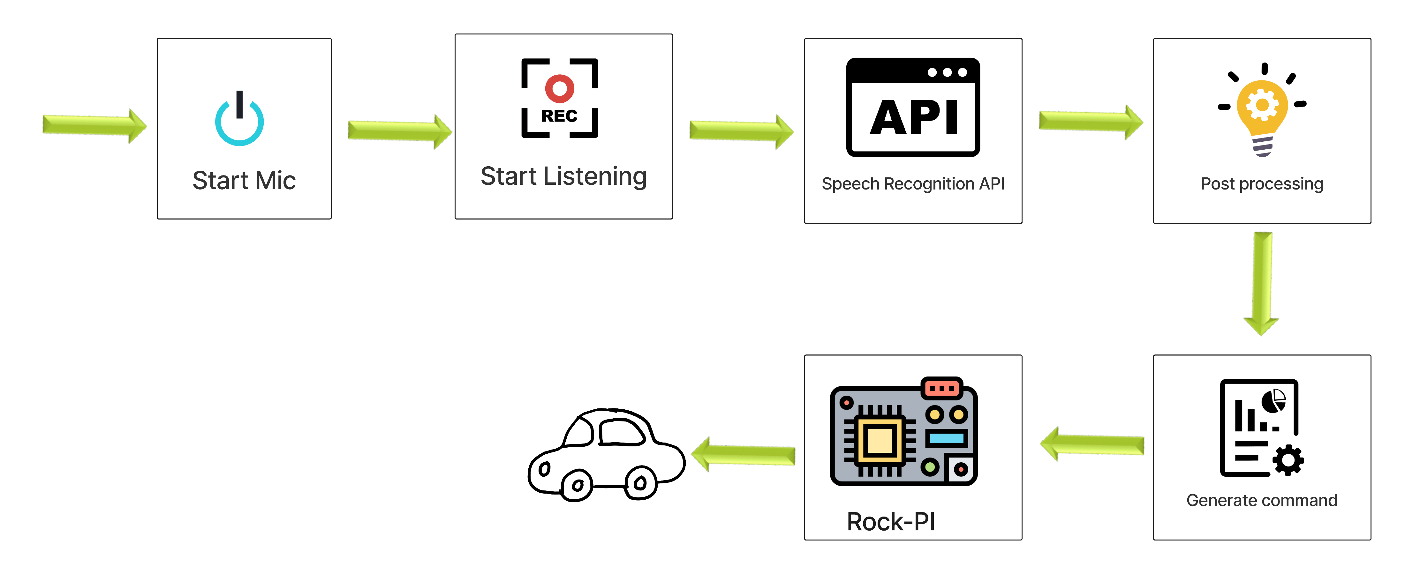
Voice Command System (Continued)
Figure-1: Voice command system

Slide 24
Remote Controller
Similar to Levenshtein strings, button pressed inputs are converted into integer values:
Forward -> 3
Backward -> 4
Left -> 1
Right -> 2
Stop -> 5

Slide 25
Remote Controller (Continued)
Integer values are stored in Web Socket database for IoT communication
Also passed through Bluetooth system if with in range
These values are later read by the micro-controller

Slide 26
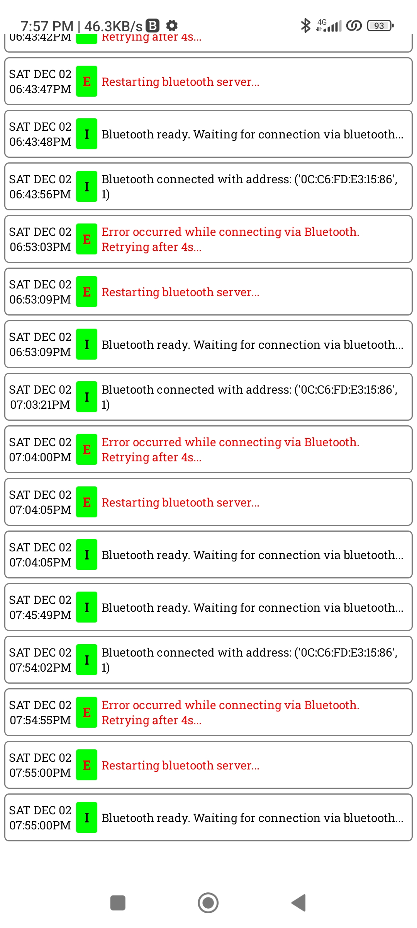
Log Cats
Shows connection and communication status
Back communication by the micro-controller are shown
Notifies errors
Also shows executed commands in the micro-controller

Slide 27
Communication System
2 Methods:
IoT (Internet of Things)
Bluetooth

Slide 28
IoT (Internet of Things)
Long range data communication
Accessed using internet
Uses Web Socket as database
Takes input from user via Android App using voice or remote controller
Writes command data into database
Reads data in micro-controller and executes it

Slide 29
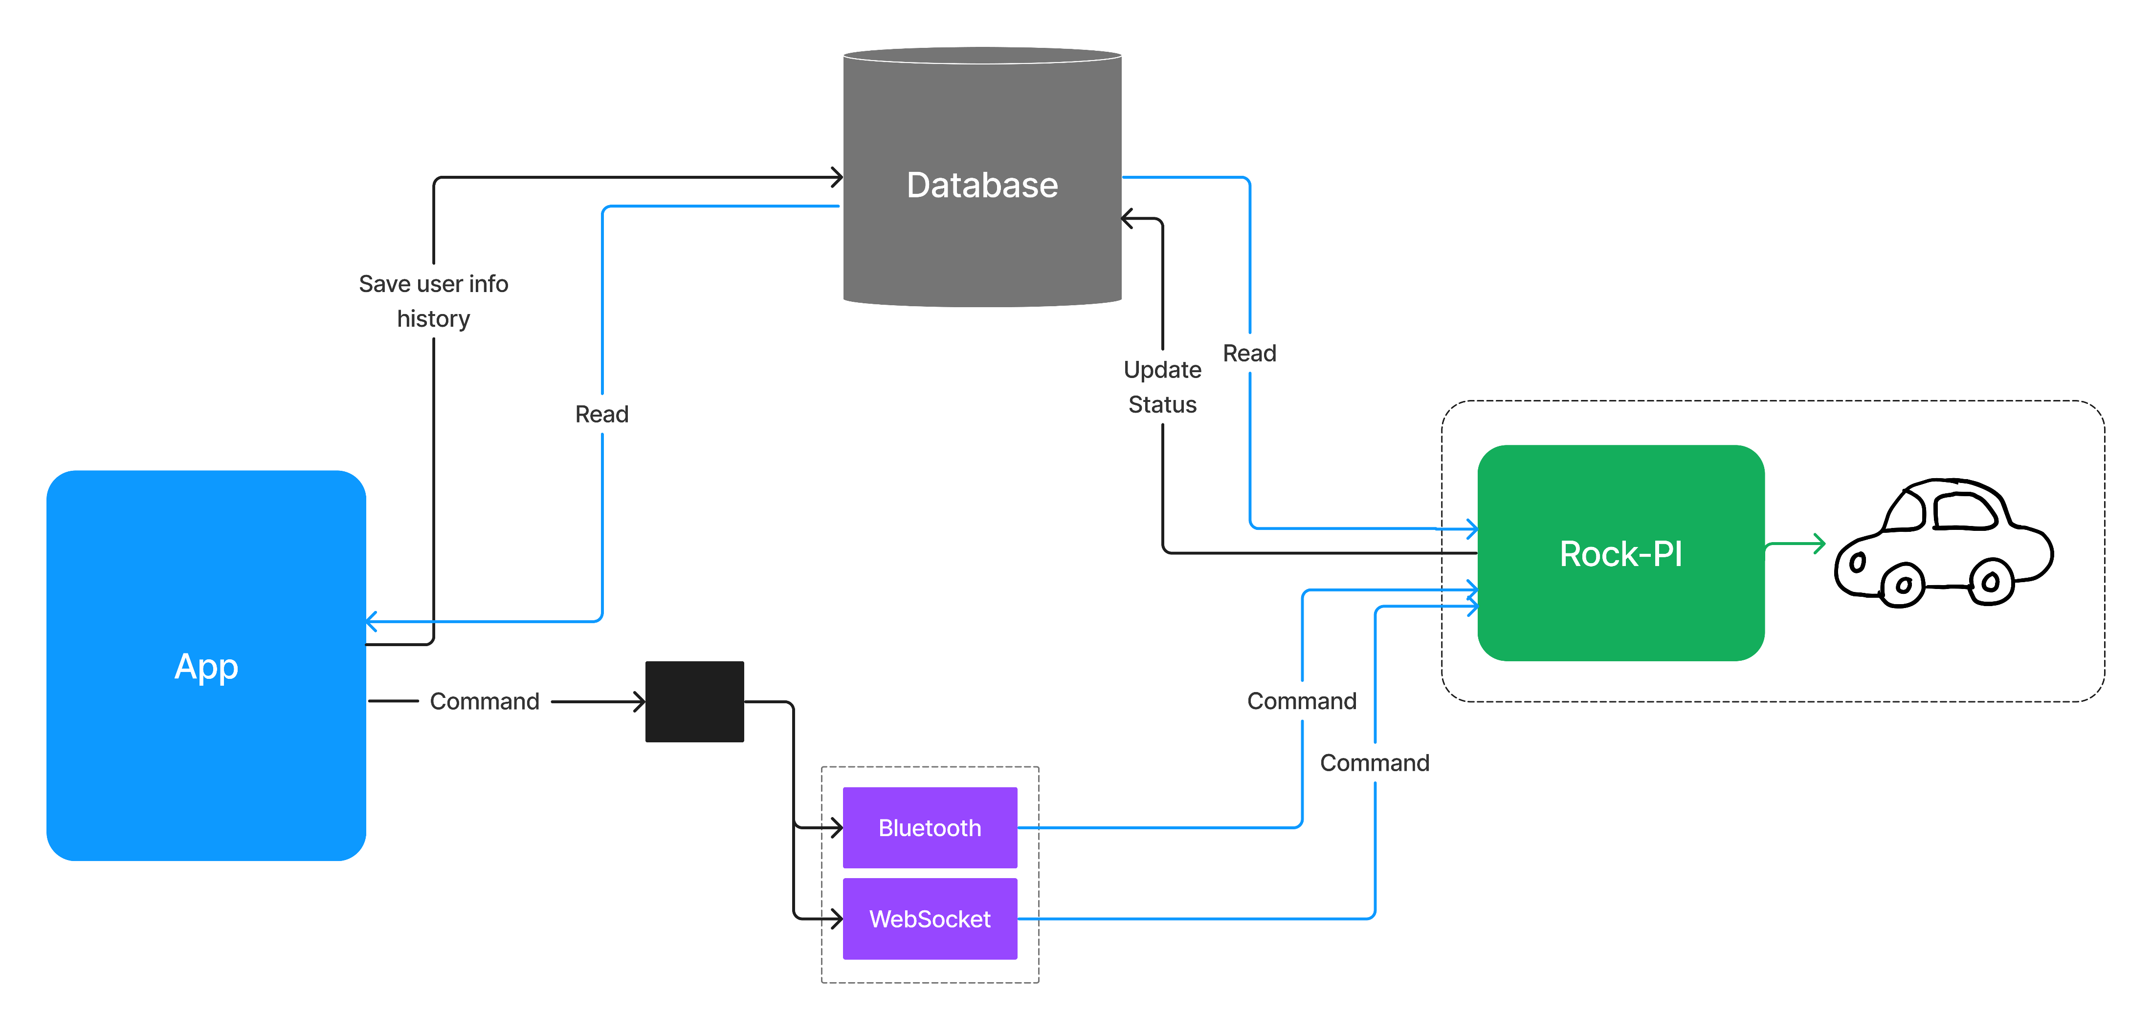
IoT (Internet of Things) (continued)
Figure-2: IoT communication system

Slide 30
IoT (Internet of Things) Issues
Latency
Multiple users accessing at the same time

Slide 31
Latency
Occurs due to internet speed and read write operations
High speed internet access in both app and micro-controller can minimize the effects
Uses Web Socket as database has significantly less latency than Firebase database
Sacrificed data protection for latency reduction

Slide 32
Multi-user Access
More than 1 user can try to access the robocar at the same time
Can cause a complete chaos due to input being changed too frequently
2 proposed solutions
Only single user access
Delay system

Slide 33
Single User Access
Block off every other users from accessing other than one
Use Boolean status variable which while connecting will be changed to True
Another user will have to check the Boolean status before connecting
Variable will be in database alongside ID
Will change to False while disconnecting
Completely disables multiple user access

Slide 34
Delay System
A fixed delay of 0.5 sec between each command read
Prevents complete chaos even if a large number of connections occur in the same robocar
Only reads and executes the immediate value after delay
Increases latency

Slide 35
Trade-off
Multiple user access inversely proportional to latency
Solving one might cause another to rise
Must find the perfect balance
High delay increases latency
No delay causes chaos
Single access limits user experience
Thus a middle ground of 0.5 sec delay is set

Slide 36
Bluetooth
Short range data communication
Accessed locally
No database or internet required
Instant actions
Very low to no latency
A range of approximately 20 meter radius

Slide 37
Bluetooth (continued)
Handled as one to one connection
Uses Bluetooth pairing system
Handled in both app and micro-controller
Constantly checks for local connection
Every 2.5 sec delay between checks
One to one connection initialization waits for 2.5 sec in case of failing to connect to a local Bluetooth method and tries to re-connect

Slide 38
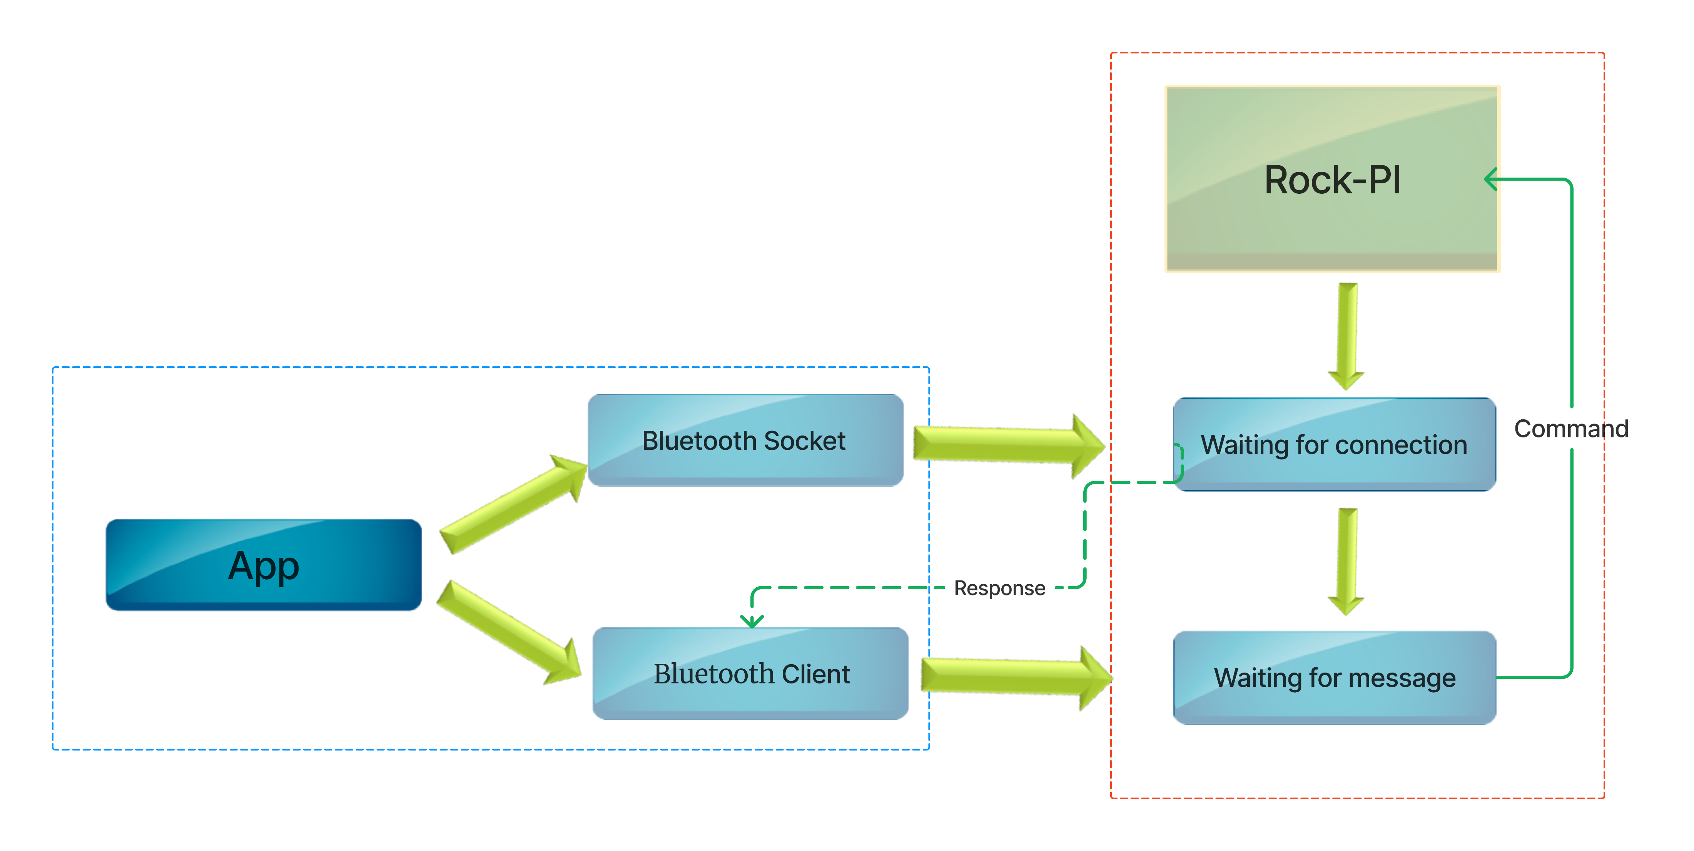
Bluetooth (continued)
Figure-3: Bluetooth communication system

Slide 39
Hardware System
4 main components:
Rock Pi 3a Micro-controller
L293D Motor Driver
Web-Cam
Python scripts through Debian OS from the micro-controller

Slide 40
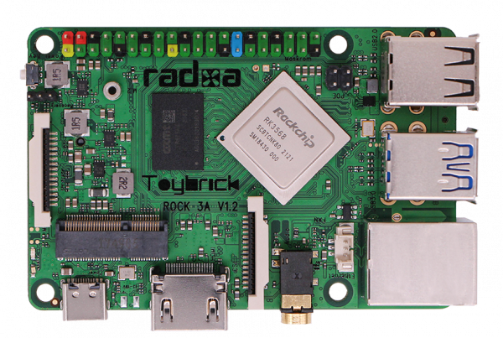
Rock Pi 3a
Advanced version of Raspberry Pi
Based on the Rock Chip RK3328 processor
Contains quad core Cortex-A55 ARM processor
Frequency of 2Ghz
Additional GPU
Contains separate wireless module
40 pins in total including 28 GPIO

Slide 41
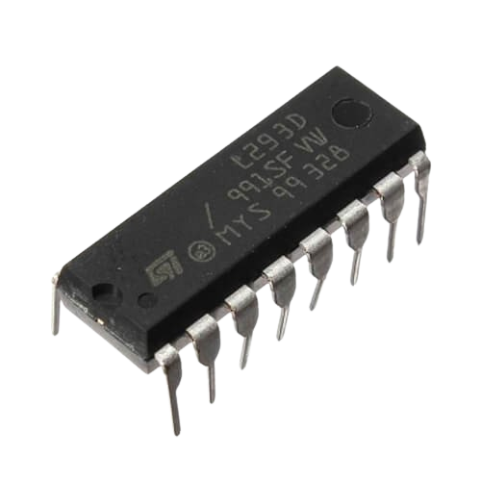
L293D Motor Driver
Interface between the Rock Pi 3a Micro-controller and the motors of the robotic car
Specifically designed for controlling the direction and speed of DC motors
Can drive two motors independently
Translates GPIO signals into precise control of the motors

Slide 42
Web-Cam
Used to capture footage ahead of the car
Uses a streaming method
Data is read through using micro-controller
Data written into Firebase
Data retrieved by the app from Firebase
Latency issues due to large data

Slide 43
Python Scripts
The software layer of the micro-controller
Reads data from database
Utilizes the GPIO pins to send signals to the L293D Motor Driver
Writes response back to the database
Implements communication in micro-controller for both IoT and Bluetooth

Slide 44
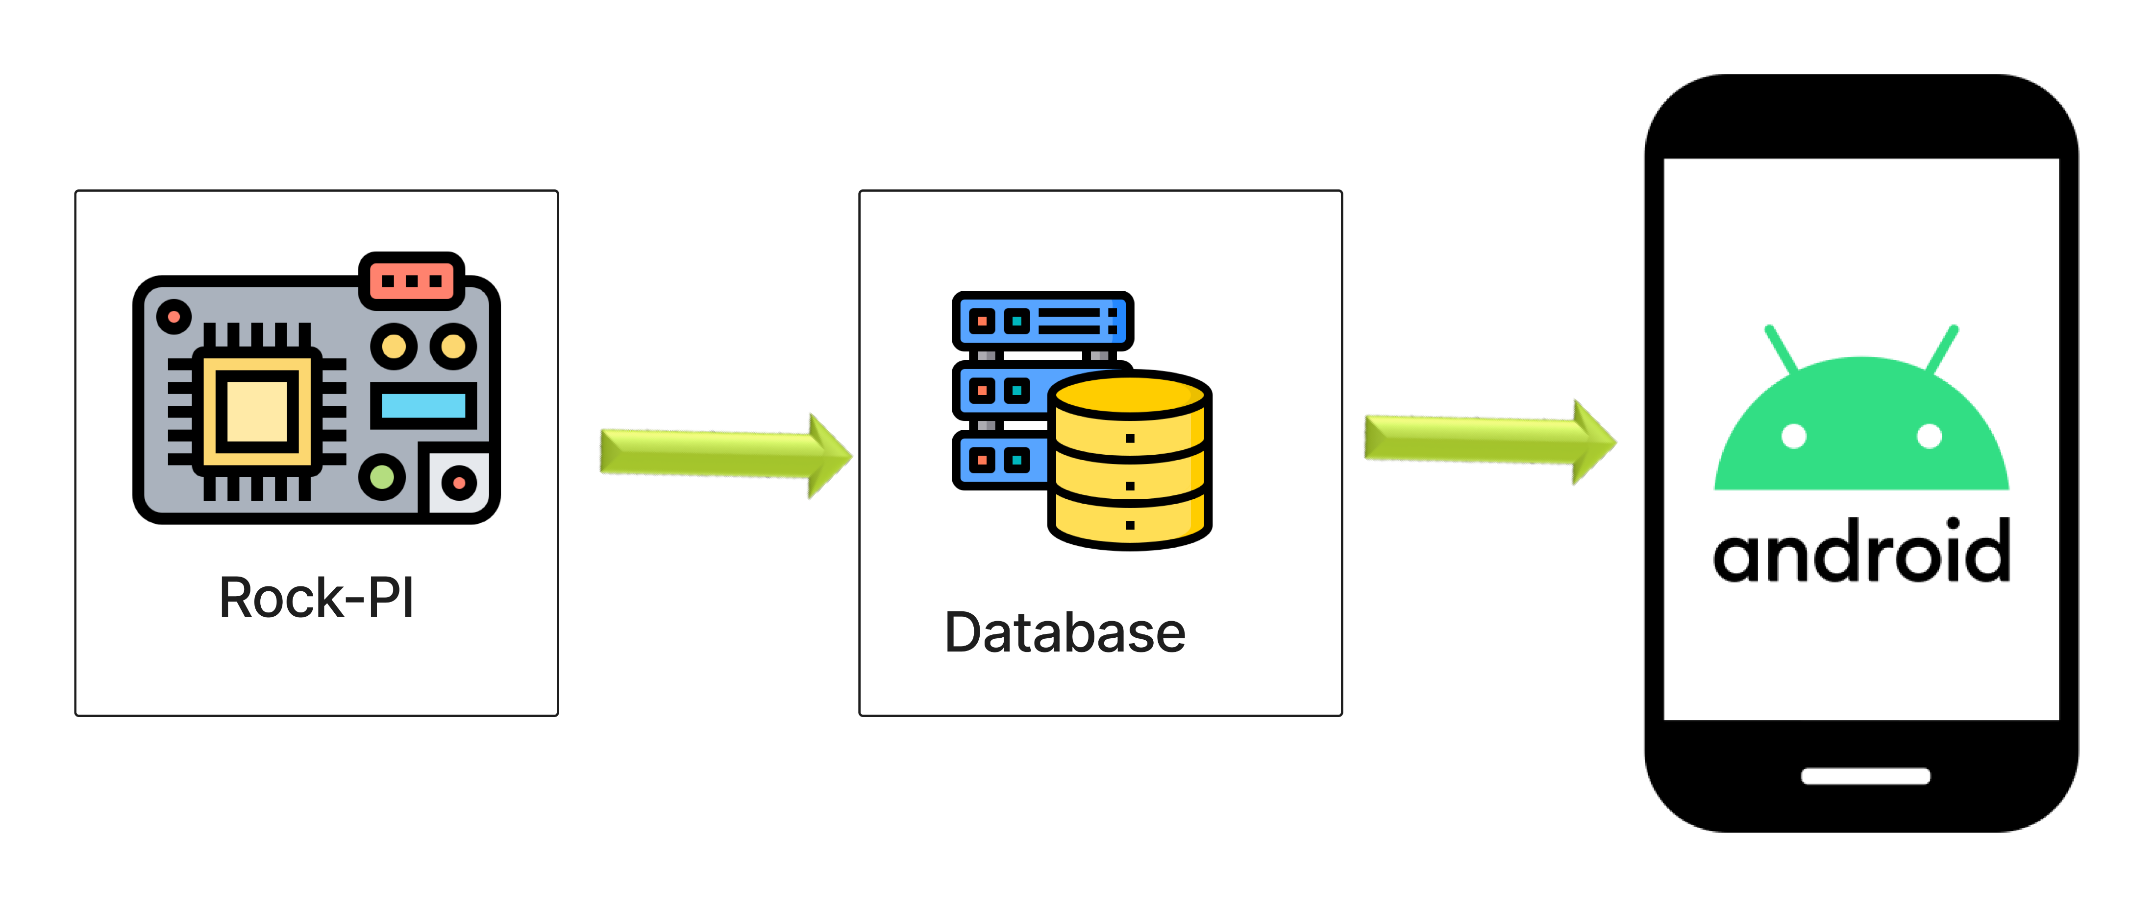
Python Scripts (continued)
Figure-4: Python script data passing to app

Slide 45
Additional Hardware Components
3 x 3.7V Batteries for Power to micro-controller
2 x 3.7V Batteries for power to DC motors
Switch to control voltage flow to motors
Connecting Wires

Slide 46
Issues
Multiple types of data arrives at the same time
Multiple types of data leaves at the same time
Might cause conflict in scheduling
Increases latency
Overlapped data could be lost

Slide 47
Solution
Parallel Execution
Multi-threading

Slide 48
Parallel Execution
Handled in micro-controller
2 different scripts
Camera Stream: Runs as a separate script as camera data is very large and causes the most latency so that it can’t effect the normal data exchange from the python scripts
Python Scripts

Slide 49
Multi-Threading
Handled in python scripts
4 different threads
Write/Update
Bluetooth
Socket/IoT
Read

Slide 50
Multi-Threading (continued)
Write/Update thread updates the responses to the database as log cats
Bluetooth thread handles data initialization and exchange from Bluetooth
Socket/IoT thread handles data regarding IoT communication
Read thread is an extra thread which is not implemented but kept as a backup for exchanging extra data with the app
Finally, data sending to L293D motor driver via GPIO pins is executed serially with the threads as it can be a result of multiple threads e.g. Bluetooth and IoT

Slide 51
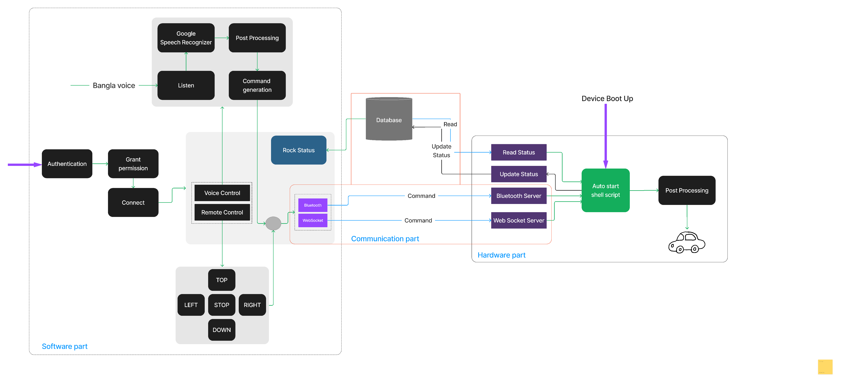
Complete System Architecture
Figure-5: Complete system architecture

Slide 52
Applications
Voice-controlled and IoT enabled wheelchair
Smart home assistance for people with disabilities
Telepresence robot for remote communication
Smart retail
Security systems
Smart agriculture
Research and exploration
Assistive robotics in healthcare

Slide 53
Future Work
Implement more advanced voice recognition models for enhanced accuracy and multilingual support
Investigate autonomous navigation capabilities, including obstacle detection and collision avoidance
Explore edge computing for real-time processing, reducing latency and enhancing responsiveness
Implement additional accessibility features, such as gesture-based controls, for a more inclusive design

Slide 54
Conclusions
Combined IoT, Bluetooth and Bengali voice Control System
Very few robotic systems with Bengali voice adaption
Could serve as a step towards futuristic robotic systems

Slide 55
Acknowledgement
Dr. Md. Sheikh Sadi Sir

Slide 56
Thank You

